Slide 1
What are Design Patterns?
Definitions and Template

Slide 2
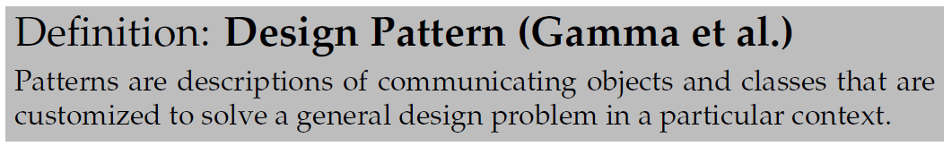
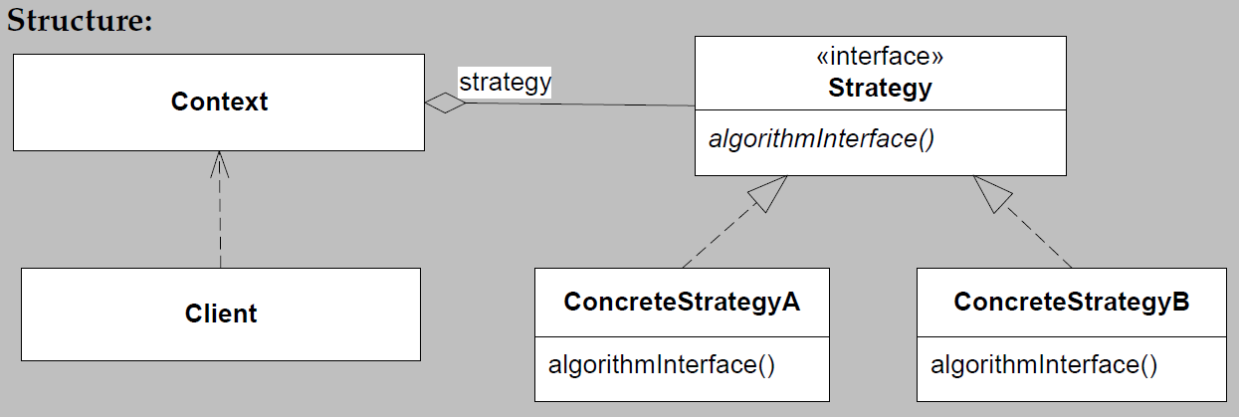
Gamma et al.’s definition
Exercise: How does it relate to…
Henrik Bærbak Christensen

Slide 3
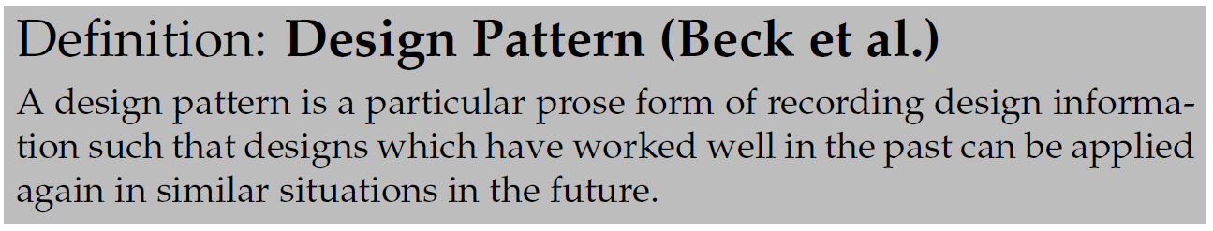
Beck et al.’s Definition
Prose form = “writing template”
The template varies from author to author.
However, must contain
  Name
  Problem
  Solution
  Consequences
Henrik Bærbak Christensen

Slide 4
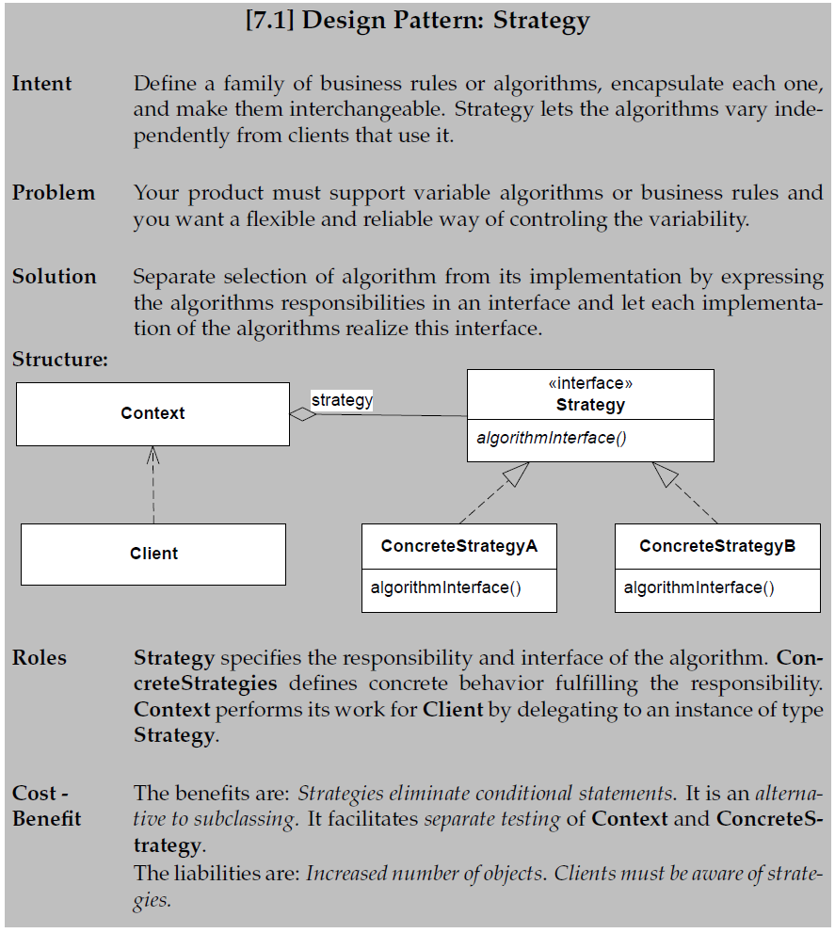
FRSE’s template
Intent
  Short description
Roles
  Responsibilities of each participating object/abstraction in the pattern
Henrik Bærbak Christensen

Slide 5
Differentiating Patterns
Be aware that many patterns are structurally equal – their UML class diagrams are more or less identical!
Patterns are defined by the problem they solve!
Strategy is the problem of
Handling variability of algorithms / business rules, making them interchangeable.
Henrik Bærbak Christensen

